Slide 1
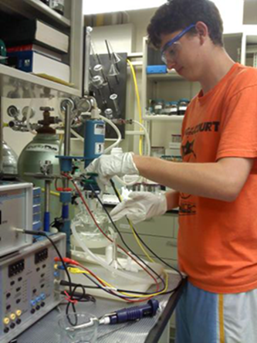
S-STEM: Bridging Our Students to Their Future
Scholarships in Science, Technology, Engineering, and Mathematics (S-STEM)
For Biomedical, Chemical, and Environmental Engineering Undergraduate Students at the University of Cincinnati
Do I Qualify?
To qualify to participate in S-STEM …
You must desire be successful in college and in your career
For BS-MS & BS-MBA dual degree programs you must be academically strong:
GPA > 3.2
ACT score > 30 or SAT equivalent.
You must earn a B+ or better in a BCEE section of Engineering Foundations (ENFD 1020)
You must demonstrate your commitment to succeed
A Scholarship Program Providing
Student Support
Tuition Compensation
Research Experiences
Business Experience
S-STEM Goals:
To produce Biomedical, Chemical and Environmental Engineering graduates who are among the first to be sought by universities, industry and investors. This program is focused on students interested in research or entrepreneurial careers.
Our vision is that S-STEM scholars will excel in a rapidly changing, technology-driven world as:
Faculty
Engineers
Scientists
Technology Managers
Leaders in starting new, technology-based companies.
In Addition To Providing Financial Support,
S-STEM …
Promotes productive academic relationships among students, faculty and other professionals
Provides
Mentoring
Workshops
Seminars
Learning Community
Provides program-specific academic courses
Provides coordinated research experiences
Supports 5-year programs (including co-op) toward:
BS+MS in your engineering discipline
BS+MBA with a Certificate in Entrepreneurship
Graduate School Preparation
Professional Preparation for students considering starting businesses through a minor in Entrepreneurship
I Want to Know More!
For more information about joining S-STEM, please visit our website:
http://www.eng.uc.edu/sstem-bcee/
or contact
Dr. Anant R. Kukreti
Department of Biomedical, Chemical and Environmental Engineering
College of Engineering and Applied Science
University of Cincinnati
Cincinnati, OH 45221-0012
Phone: 513-556-4105
Fax: 513-556-6754 / 513-556-4162
E-Mail: anant.kukreti@uc.edu
S-STEM Is Funded By The
National Science Foundation,
Grant #1356656
College of Engineering and Applied Science

